Slide 1

Working with Topics
Ross Deans Kristensen-McLachlan
Assistant Professor
Cognitive Science and Humanities Computing
rdkm@cc.au.dk

Slide 2
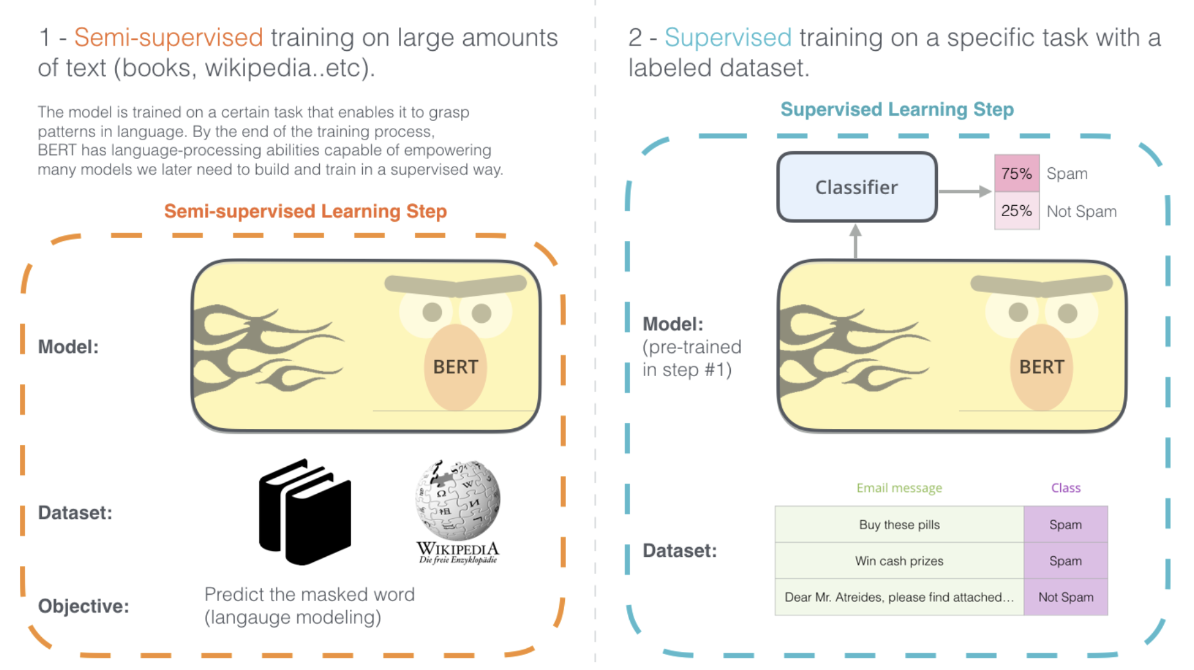
Transfer Learning
https://jalammar.github.io/illustrated-bert/

Slide 3
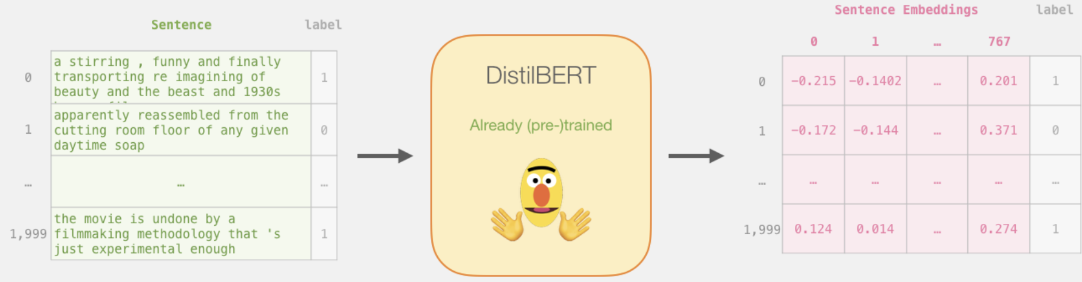
From text to numbers
http://jalammar.github.io/a-visual-guide-to-using-bert-for-the-first-time/

Slide 4
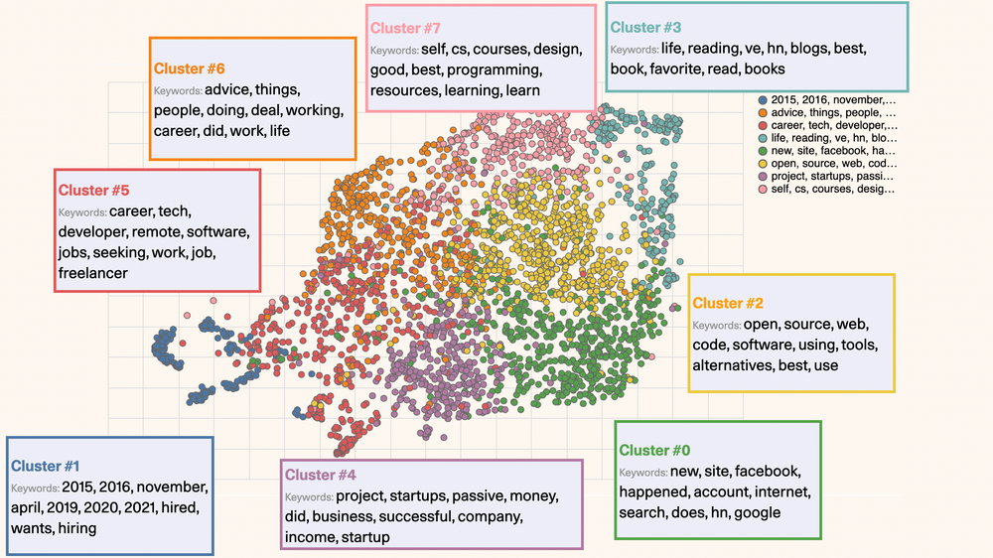
Finding topics
https://docs.cohere.com/docs/clustering-hacker-news-posts

Slide 5
Why use it?
Information extraction
Finding most important “themes” in your data
Information retrieval
Annotating data based on topics for semantic search
Learning about your data
How does it change over time?
What kinds of topics get the most engagement?
Etc, etc

Slide 6
Things to Explore
How do topics in the data differ across different datasets?
What are the most common topics per domain?
Brainstorm ideas about applications!

